Slide 1
Digital portfolio
STUDENT NAME: KAVIYA.S
REGISTER NUMBER AND NMID: 222409867 and 7C6C3E5EEAB54CF81C742223A3A66C06
DEPARTMENT : COMPUTER SCIENCE WITH DATA SCIENCE
COLLEGE : UNIVERSITY OF MADRAS
J.N.N college of arts and science

Slide 2
PROJECT TITLE
🎯 “ Crafting My Digital Identity – A Responsive Portfolio Website”
Notes:
“Crafting My Digital Identity – A Responsive Portfolio Website”

Slide 3

AGENDA
1.Problem statement
2.Project overview
3.End users
4.Tools and Technologies
5.Portfolio design and Layout
6.Features and Functionality
7. Result and Screenshot
8.Conclusion
9.Github link

Slide 4
💡PROBLEM STATEMENT
In the modern digital era, presenting one’s professional identity has moved beyond traditional paper resumes. Employers and organizations expect candidates to showcase not only their qualifications but also their practical skills, creativity, and digital presence. Conventional resumes are often static, text-heavy, and lack interactivity, making it difficult for recruiters to evaluate real potential. A personal portfolio website bridges this gap by offering a dynamic, visually appealing, and accessible platform where individuals can highlight their technical expertise, academic background, projects, and achievements in a structured manner. By creating a responsive portfolio website using HTML and CSS, this project aims to provide an interactive medium for candidates to present their profile and work in a professional format that leaves a lasting impression on recruiters and collaborators.

Slide 5
📖 PROJECT OVERVIEW –PORTFOLIO WEBSITE
A Portfolio Project is a digital platform that highlights an individual’s skills, achievements, projects, and experiences in an engaging and structured manner. Unlike traditional resumes, a portfolio acts as an interactive resume, providing recruiters, clients, and evaluators with a clear understanding of the candidate’s capabilities.

Slide 6
Purpose of the project
To create a personal portfolio website that reflects professional identity. To present academic, technical, and creative work in a well-organized format. To attract recruiters, clients, and collaborators by showcasing strengths effectively. To demonstrate web development skills using HTML and CSS (with optional JavaScript).

Slide 7
Key features of the portfolio website
1. Home Page / Introduction → A brief introduction and tagline. 2. About Me Section → Education, personal background, and skills. 3. Projects Section → List of completed projects with details, images, and links. 4. Skills Section → Technical expertise and soft skills. 5. Resume / CV → Downloadable or viewable resume. 6. Contact Section → Email, LinkedIn, GitHub, or contact form.

Slide 8
End users
Recruiters & Employers → To assess skills and suitability for job roles. Clients → To review past work before offering projects. Teachers / Examiners → For academic evaluation. Peers & Community → For networking and collaboration opportunities.

Slide 9
Technologies used
HTML5 → For website structure and content. CSS3 → For styling, design, and responsiveness. (Optional) JavaScript → For interactivity (animations, sliders, form validation).

Slide 10
👥 END USERS IN A PORTFOLIO PROJECT
⭐A personal portfolio website is designed for multiple categories of users, each with a specific purpose: 1. Recruiters / Hiring Managers → To evaluate skills, projects, and achievements before offering jobs or internships. 2. Clients (Freelancers) → To review past work and decide whether to hire for new projects. 3. Teachers / Examiners (Academic Purpose) → To assess the portfolio as part of coursework or project submission. 4. Peers / Colleagues / Community → To view skills and collaborate on projects, networking, or sharing references. 5. General Audience / Visitors → To learn about the individual’s professional background and digital presence.

Slide 11
⚒️ Tools used
Tools are the software and platforms applied to design, develop, and present the portfolio website: Visual Studio Code (VS Code) → Code editor for writing HTML & CSS. Google Chrome / Firefox → Browsers for testing and previewing the website. GitHub / Netlify (Optional) → Hosting platform for publishing the portfolio online. Canva / Figma (Optional) → For designing logos, banners, or UI mockups.

Slide 12
🔧 Techniques Applied
Techniques represent the methods and practices used while building the portfolio website: HTML5 → To define the structure and content (sections like About, Skills, Projects, Contact). CSS3 → For styling, layout, and enhancing visual appeal. Responsive Design → Ensuring the website works on desktop, tablet, and mobile devices. Navigation Menu → Providing smooth access to different sections. (Optional) JavaScript → For interactivity (sliders, animations, contact form validation).

Slide 13
🎨 PORTFOLIO DESIGN AND LAYOUT
The design and layout of the portfolio project aim to provide a clean, professional, and user-friendly experience. The website ensures smooth navigation, balanced visual appeal, and responsiveness across multiple device such as desktops, tablets, and smartphones. ⭐1. Digital principal
The portfolio website is designed based on the following principles: Simplicity → Minimalist design with clear sections and clutter-free presentation. Consistency → Uniform use of fonts, colors, spacing, and alignment across all pages. Readability → Proper use of headings, subheadings, font sizes, and text contrast for better readability. Responsiveness → Adaptive layouts for seamless viewing on different screen sizes. Visual Appeal → Balanced combination of images, icons, and color schemes to enhance presentation.

Slide 14
2.Layout Structure The portfolio website is divided into multiple sections for better organization: Header / Navigation Bar → Displays the individual’s name/logo and provides quick navigation links (Home, About, Projects, Contact). Home / Introduction Section → A welcome message, professional tagline, and profile picture. About Me Section → Personal background, academic details, and technical skills. Skills Section → Showcased using lists, icons, or graphical elements (skill bars/charts). Projects Section → Highlights academic and technical projects with descriptions, images, and links (GitHub/live demo). Resume Section (Optional) → Allows users to view or download a professional resume. Contact Section → Provides email, phone number, social media links, or a contact form. Footer → Contains copyright details, quick navigation links, and acknowledgements.

Slide 15
3. Layout Techniques Used The following web design techniques have been applied to ensure functionality and responsiveness: HTML5 → To divide the portfolio into semantic sections (header, nav, section, footer). CSS3 (Flexbox & Grid) → For structured alignment of elements in rows and columns. Media Queries → To optimize design for multiple devices (mobile, tablet, desktop). Navigation Design → Includes sticky navigation, smooth scrolling, and hover effects for better user interaction.

Slide 16
📂 FEATURES AND FUNCTIONALITIES
🔹 Features User-Friendly Interface → Clean and professional design for smooth navigation. Responsive Design → Works seamlessly on desktops, tablets, and mobiles. Navigation Menu → Quick access to different sections (About, Projects, Contact). About Section → Displays personal background, education, and career details. Skills Section → Showcases technical and soft skills. Projects Showcase → Portfolio of completed projects with descriptions and links. Resume Integration → Option to view or download resume (optional). Contact Section → Email, phone number, LinkedIn, GitHub links. Footer Section → Copyright and acknowledgements.

Slide 17
🔹 Functionality Interactive Navigation → Smooth scrolling and clickable links. Hyperlinks → GitHub repositories, LinkedIn, or project demo links. Responsive Layout → CSS Flexbox, Grid, and media queries for mobile-friendly design. Contact Form (Optional) → Direct message option for recruiters/clients. Hover Effects & Animations → Enhances interactivity. Cross-Browser Compatibility → Works across Chrome, Firefox, Edge, etc.

Slide 18
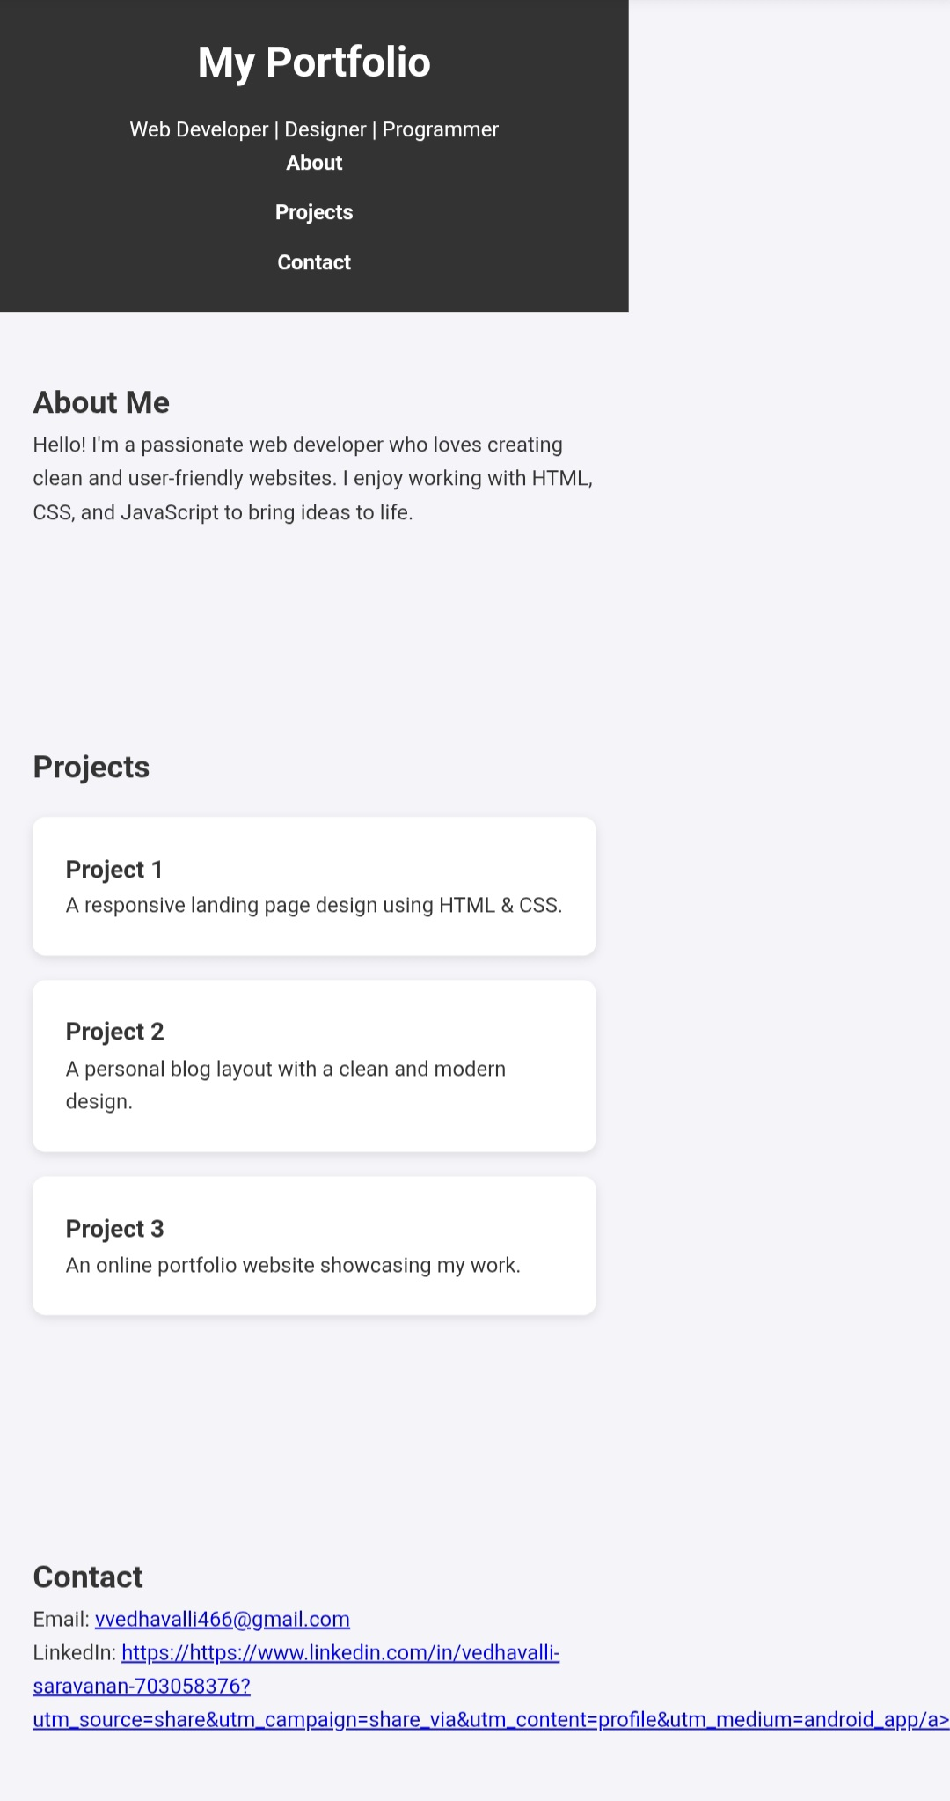
RESULTS AND SCREENSHOT

Slide 19
✅CONCLUSION
The Portfolio Project demonstrates how HTML and CSS can be effectively used to design a responsive, interactive, and professional website. The portfolio serves as a digital resume, allowing individuals to showcase their profile, skills, and projects in an organized way. It meets the objectives of providing: A user-friendly platform for self-presentation. A responsive design that works on all devices. A professional digital identity for recruiters, clients, and academic evaluators. This project not only reflects the candidate’s personal and professional details but also highlights their front-end development skills, contributing to academic, career, and professional growth.

